Slide 1
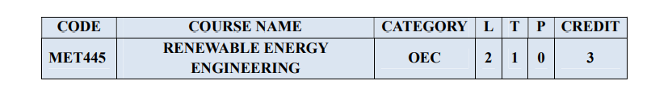
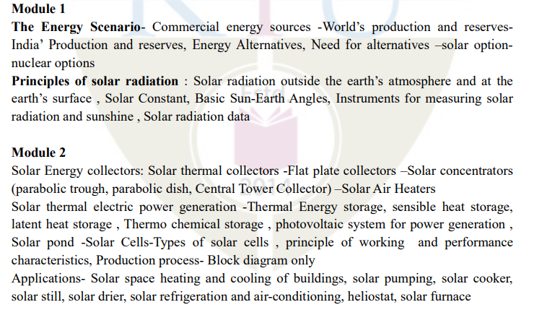

Slide 2
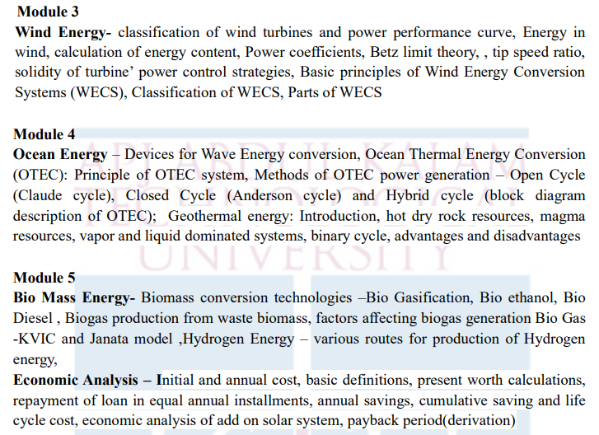

Slide 3
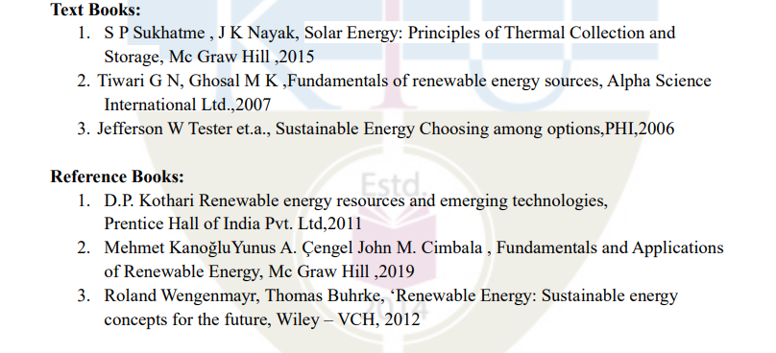

Slide 4
Sun
E ≈ 1.06 × 10⁻¹² joules per reaction

Slide 5
Energy from the Sun
Age Almost 5 billion years
Mean distance from earth 149 600 000 km
Period of rotation 25 day at the equator
Diameter 1392 000 km (10⁹ x the earth’s diameter)
Mass 1993 x 1027 tons (333 000 x earth’s mass)
Temperature 15 x10⁶ ⁰C at center 6000 ⁰C on surface
Energy radiation 380 x 10²¹ kW
The earth receives 170 x 10¹² kW

Slide 6
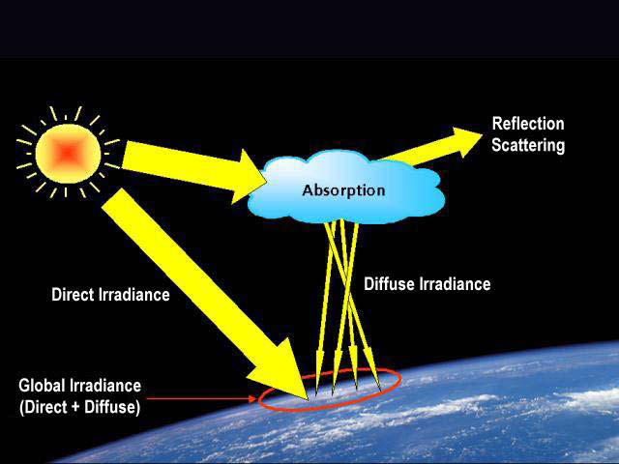
Solar Radiation

Slide 7
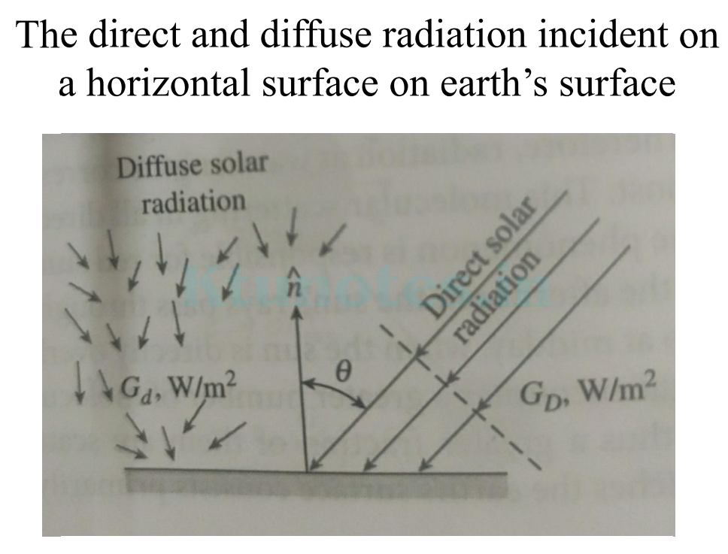

Slide 8
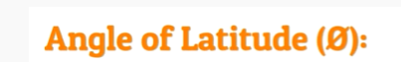
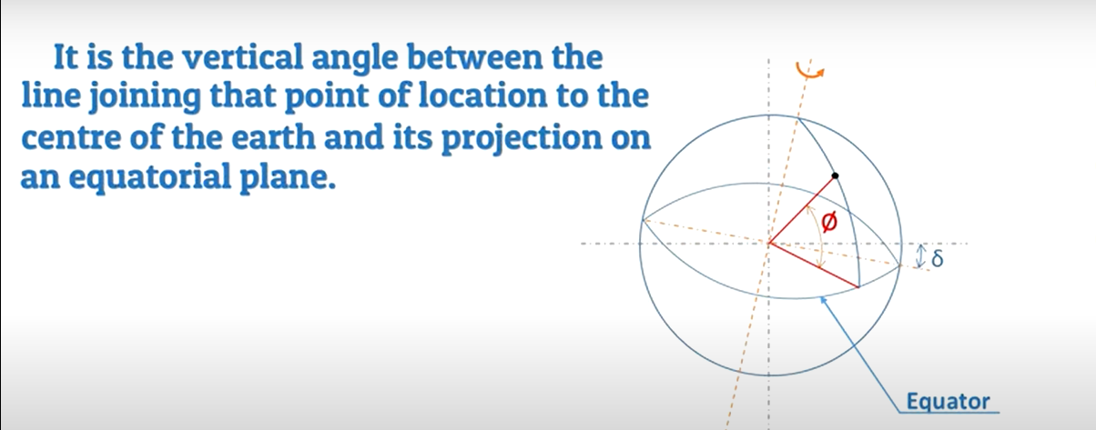

Slide 9
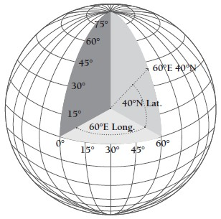
+ in the north pole
- in the south pole

Slide 10
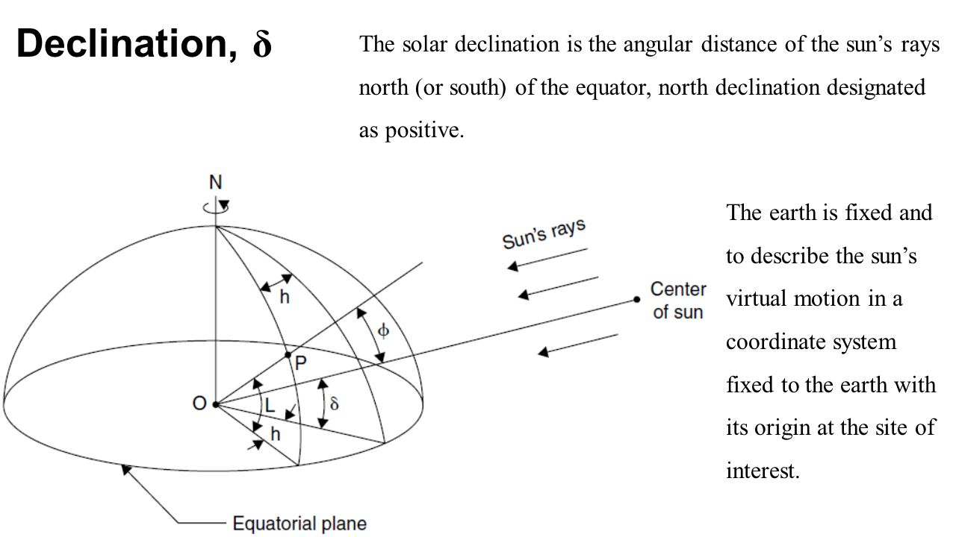
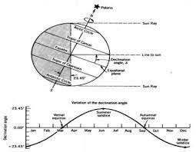
Solar declination is defined as the angle between the line joining the centers of the Sun and the Earth and its projection on the equatorial plane.

Slide 11
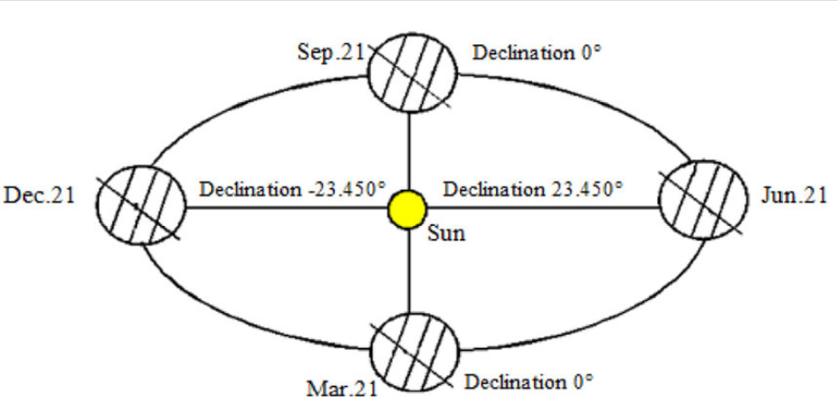
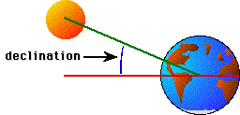

Slide 12
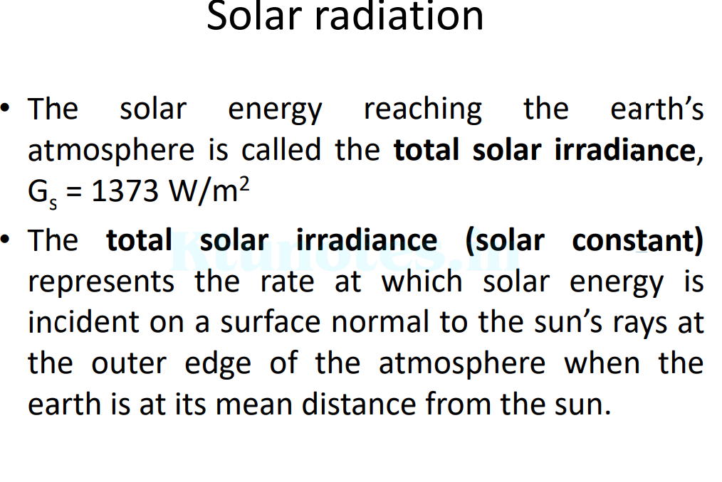

Slide 14
Zenith angle is +90 degrees during sun rise
-90 degrees during sun set

Slide 18
Solar Elevation Angle (Altitude): This angle measures the height of the Sun above the horizon as observed from a specific location on Earth. It ranges from 0° (on the horizon) to 90° (directly overhead). Higher values indicate the Sun is higher in the sky, leading to more direct sunlight and potentially higher temperatures.
Solar Azimuth Angle: This angle defines the direction of the Sun relative to the observer's location. It is measured clockwise from true north. A solar azimuth angle of 0° indicates the Sun is due north, 90° means it's due east, 180° is due south, and 270° is due west.
Solar Declination Angle: This angle measures the latitude at which the Sun's rays are perpendicular to the Earth's surface. It changes throughout the year as the Earth orbits the Sun, causing the seasons. The solar declination angle is 0° during the equinoxes, positive during the northern hemisphere's summer, and negative during its winter.

Slide 19
Hour Angle: This angle measures the time since solar noon, which is the time when the Sun is at its highest point in the sky. It is often expressed in degrees, with 15° per hour of time.
Inclination of Earth's Axis: Earth's axis is tilted relative to its orbital plane around the Sun. This tilt is responsible for the changing seasons as different parts of the Earth receive varying amounts of sunlight throughout the year. The axial tilt is approximately 23.5°.
Angle of Incidence: This angle refers to the angle at which sunlight strikes a surface. The more direct the sunlight, the smaller the angle of incidence, resulting in more concentrated energy per unit area.

Slide 20
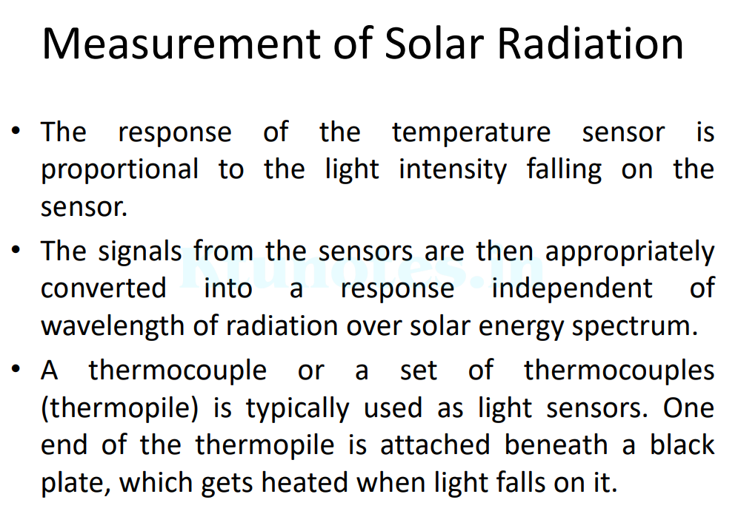

Slide 21
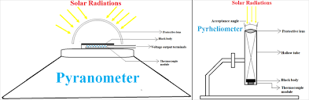

Slide 22
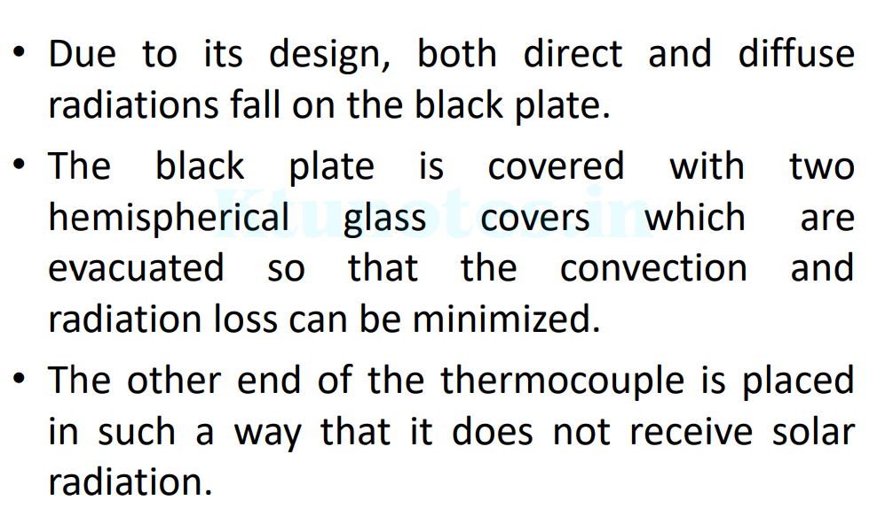
Pyranometer

Slide 23

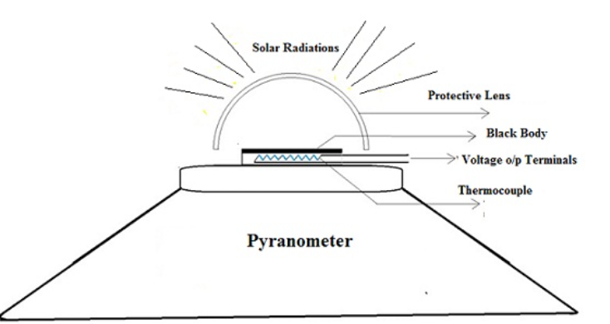

Slide 24
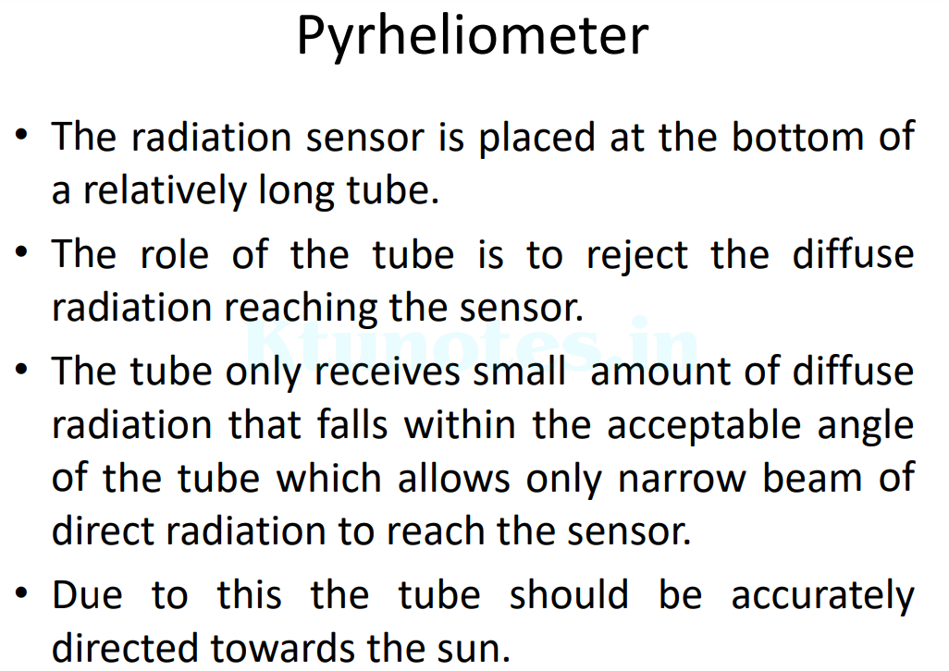

Slide 25
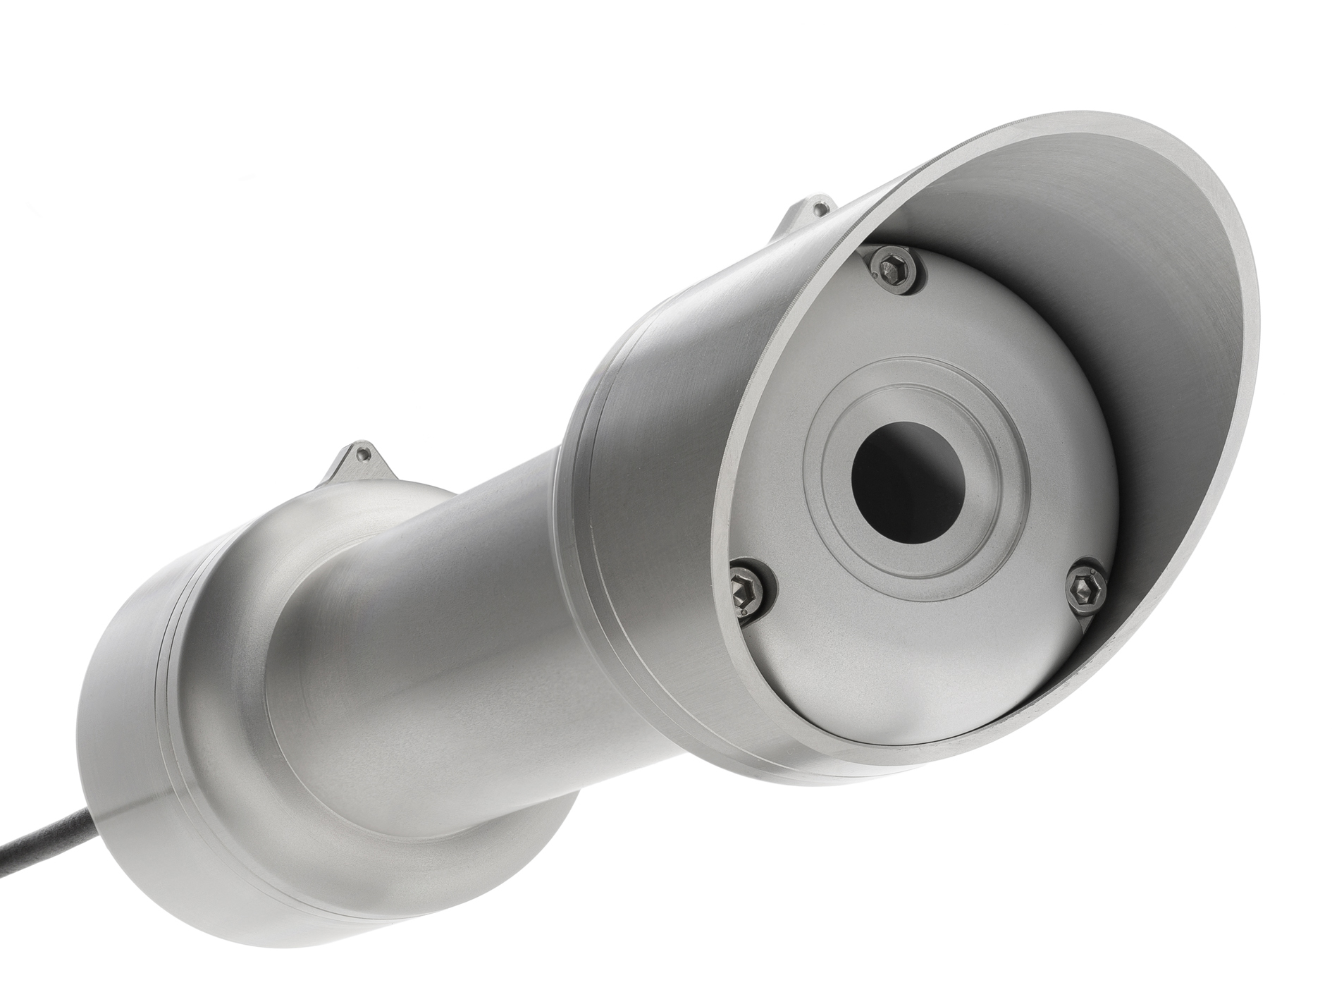
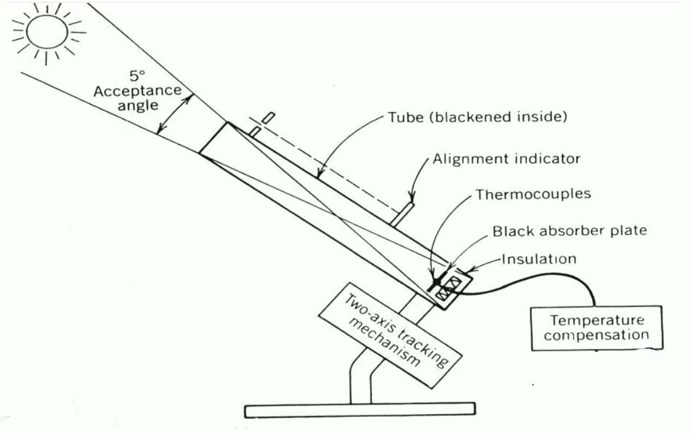

Slide 26
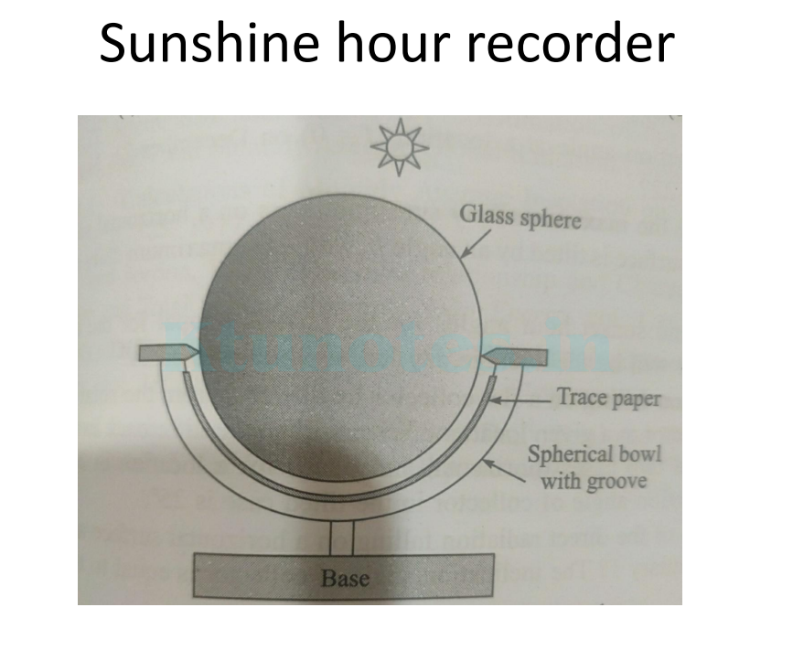

Slide 27
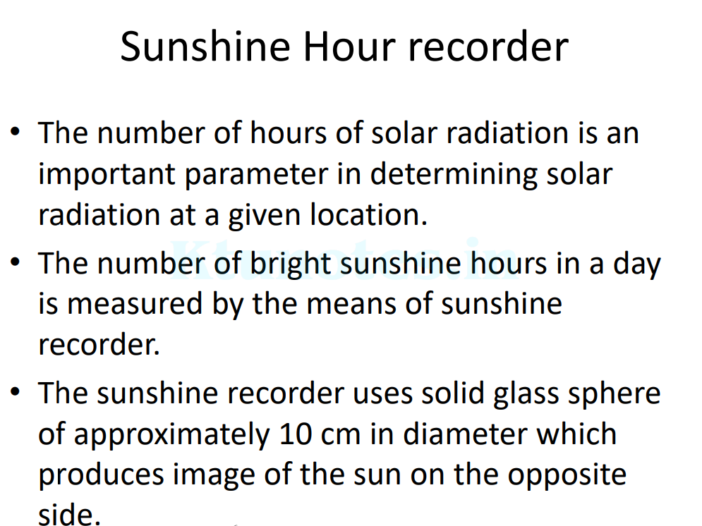

Slide 28
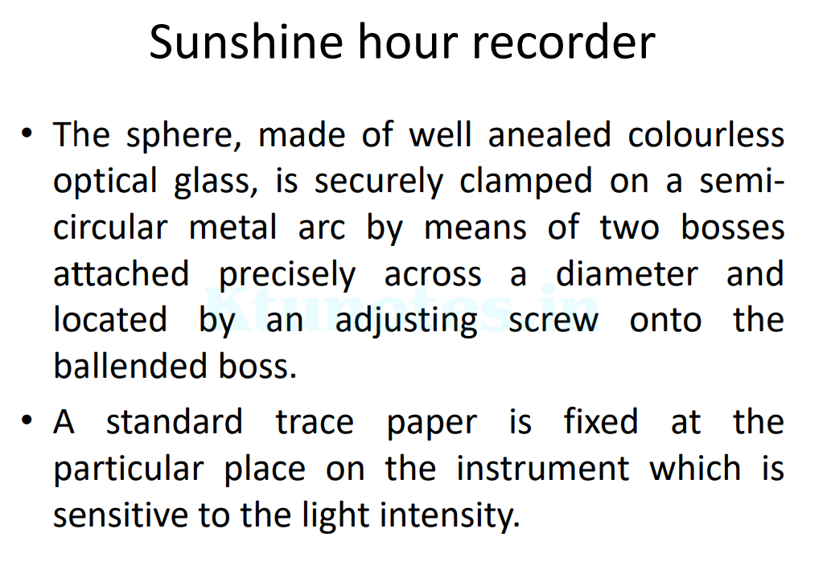

Slide 29
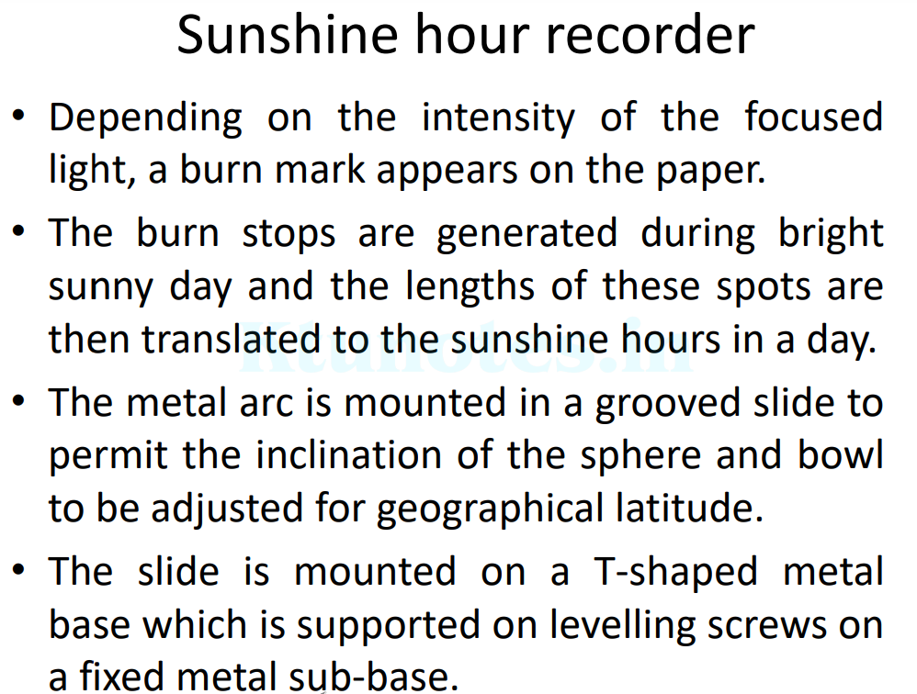

Slide 30
